Slide 1
Capstone Project of Applied Data Science (Week 5): The Battle of Neighborhoods

Slide 2
Outline
Introduction
Data Source
Methodology
Results
Discussion
Conclusion

Slide 3
Introduction
My friend Jimmy is moving from The Woodland, Texas. To Austin, Texas.
I have been asked to find a good neighborhood for him.
His requirements:
same types of amenities as his current neighborhood
as close to his new company as possible

Slide 4
Data Source
# | Data | Data Source
1 | Address of his current house | Jimmy
2 | Latitude and longitude of his current house | Foursquare API
3 | The borough and neighborhood of his current house | Foursquare API
4 | Amenities in his current neighborhood, and types of these amenities | Foursquare API
5 | Address of his new company | Jimmy
6 | Latitude and longitude of his new company | Foursquare API
7 | Boroughs near his new company | Foursquare API
8 | Neighborhoods in Austin | Wikipedia
9 | Amenities in the neighborhoods in the nearby broughs, and types of these amenities | Foursquare API

Slide 5
Methodology
Two steps of filtering
Qualification according to amenities-similarity
For each neighborhood, make the avenue-type vector
Use K-Means method to do clustering
Get the neighborhoods in the same cluster as his current neighborhood.
Qualification according to distance to company
Calculate the distance form the company to the remaining neighborhoods
Find the one closest to the company

Slide 6
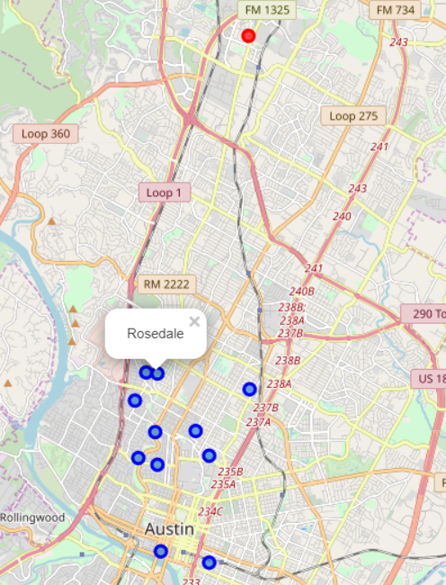
Results
Company
Rosedale is the optimal neighborhood
Its amenities are similar
It is closest to the company
It is rather independent of the number of clusters
Neighborhoods with similar amenities

Slide 7
Discussion
Our two criteria: amenities and distance.
Our workflow: multiple steps of qualification
For more complicated requirement (low crime rate, good kindergarten, major race of residents), our workflow still applies, however, we need different types of data source than the Foursquare API.

Slide 8
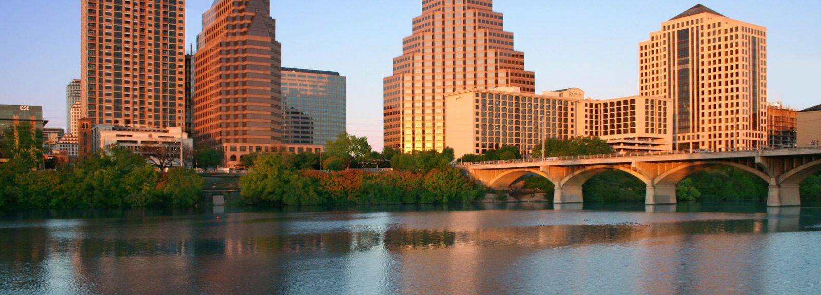
Conclusion
I suggest my friend Jimmy to find a house in Rosedale, Austin, where he can find similar amenities as his current neighborhood, and he will not waste a lot of time in transportation to company.
I am happy that what I learnt from the course can be applied in real life.

Slide 9
Conclusion

